Slide 1

Open Shortest Path First (Advanced)
Safwan Muntasir (Sufi) Networking Enthusiast

Slide 2
Before starting this study material, in case if you didn’t check, it is recommended to go through the previous version named “OSPF Basic”

Slide 3
LSA Types
LSA stands for Link State Advertisements. They are used to exchange information about the network's topology.
There are total 11 types of LSAs-
Type 1 Router LSA: Advertises the router itself, directly connected interface addresses, link states & costs, and neighbor routers.
Type 2 Network LSA: Advertises the networks that the router is connected to, as well as the routers that are connected to those networks. Network LSA is generated by DR on multi-access networks, and the LSA which DR get from DROTHERs area LSA type 1.
Type 3 Summary LSA: Advertises a summary of the routes in an area to other areas, generated by ABRs.
Type 4 ASBR Summary LSA: Advertises a summary of the routes to external ASs to other areas, generated by ABRs.
Type 5 AS External LSA: Advertises routes to external ASs, generated by ASBRs.
Type 6 Multicast OSPFv3 LSA: Advertises the multicast groups that the router is a member of, used in OSPFv3 (IPv6 networks).
Type 7 NSSA External LSA: Advertises routes to external networks in an NSSA.
Type 8 External Attributes LSA: Advertises additional information about external routes, such as the next hop address and the metric.
Type 9 Opaque LSA: Advertises prefixes within an OSPFv3 area, used for future extensions or proprietary information.
Type 10 Opaque LSA: Similar purposes as Type 9, but they serve as a distinct type for differentiating information.
Type 11 Opaque LSA: Similar purposes as Type 9 and type 10, used for additional custom extensions or proprietary data.
***Type 1 & 2 are used for same area (O), type 3 for different area (OIA), type 4 & 5 for external area (E1/E2) and type 7 for nssa area.
***Type 6 is not used and type 8-11 are advanced analysis which are commonly used with PGP and MPLS OSPF integration for traffic engineering.

Slide 4
LSA Header
Link-State Age: Time, in seconds, elapsed since the LSA was originated. An LSA ages in the LSDB (added by 1 per second), but does not age during transmission.
Link-State Type: It is a number (1-7) that indicates the type of LSA.
Link-State ID: What the Link State ID contains depends on the type of LSA
Advertising Router: The router ID of the router that generated the LSA.
LS Sequence Number: Used by other routers to judge new and old LSAs.
LS Checksum: Checksum of the LSA except the LS age field.
Length: Length in bytes of the LSA, including the LSA header.
IP Header OSPF Header OSPF LSA Header
0 7 15 31
LS Age Options LS Type
Link-State ID
Advertising Router
LS Sequence Number
LS Checksum Length
All LSAs have the same header

Slide 5
Router LSA Type 1 Format
V (Virtual Link): V=1 if the router that originated the LSA is a virtual link endpoint.
E (External): E=1 if the router that originated the LSA is an ASBR.
B (Border): B=1 if the router that originated the LSA is an ABR.
# Links: Number of the router links (interfaces) to the area.
Link ID: Determined by link type.
Link Data: Determined by link type.
Type: Link type. A value of-
1 indicates a point-to-point link to a remote router
2 indicates a link to a transit network
3 indicates a link to a stub network
4 indicates a virtual link.
#TOS: Number of different TOS metrics given for this link. If no TOS metric is given for the link, this field is set to 0. TOS is not supported in RFC 2328. The #TOS field is reserved for early versions of OSPF.
Metric: Cost of using this router link.
TOS: IP type of service that this metric refers to.
TOS Metric: TOS-specific metric information.
IP Header OSPF LSA Header OSPF Router LSA
0 7 15 31
0 V E B 0 # Links
Link ID
Link Data
Type #TOS Metric
…
TOS 0 TOS Metric
Link ID
Link Data
…

Slide 6
Network LSA Type 2 Format & Summary LSA Type 3 or 4
IP Header OSPF Header OSPF Network LSA
IP Header OSPF Header OSPF Summary LSA
0 7 15 31
0 7 15 31
Network Mask
Network Mask
Attached Router
0 Metric
…
TOS TOS Metric
…
Network Mask: The mask of the network (a broadcast or NMBA network).
Attached Router: The IDs of the routers, which are adjacent to the DR, including the DR itself.
Link State ID: For a type 3 LSA, it is an IP address outside the area. For a type 4 LSA, it is the router ID of an ASBR outside the area.
Network Mask: The network for the type 3 LSA. It is set to 0.0.0.0 for the type 4 LSA.
Metric: The metric to the destination.

Slide 7
AS External LSA Type 5 Format
IP Header OSPF LSA Header OSPF AS External LSA
Link State ID: The IP address of another AS to be advertised. When describing a default route, the link state ID is always set to default destination (0.0.0.0) and the network mask is set to 0.0.0.0.
Network Mask: The IP address mask for the advertised destination.
E (External Metric): The type of the external metric value, which is set to 1 for type 2 external routes, and set to 0 for type 1 external routes.
Metric: The metric to the destination.
Forwarding Address: Data traffic for the advertised destination is forwarded to this address.
External Route Tag: A tag attached to each external route. This is not used by the OSPF protocol. It may used to manage external routes.
TOS: IP type of service that this metric refers to.
TOS Metric: TOS-specific metric information.
0 7 15 31
Network Mask
E 0 Metric
Forwarding Address
External Route Tag
E TOS TOS Metric
Forwarding Address
External Route Tag
…

Slide 8
NSSA External LSA Type 7 Format
IP Header OSPF LSA Header OSPF AS External LSA
Link State ID: The IP address of another AS to be advertised. When describing a default route, the link state ID is always set to default destination (0.0.0.0) and the network mask is set to 0.0.0.0.
Network Mask: The IP address mask for the advertised destination.
E (External Metric): The type of the external metric value, which is set to 1 for type 2 external routes, and set to 0 for type 1 external routes.
Metric: The metric to the destination.
Forwarding Address: Data traffic for the advertised destination is forwarded to this address.
External Route Tag: A tag attached to each external route. This is not used by the OSPF protocol. It may used to manage external routes.
TOS: IP type of service that this metric refers to.
0 7 15 31
Network Mask
E TOS TOS Metric
Forwarding Address
External Route Tag
…

Slide 9



Area Types
Area 0
Standard Area 1
External Network RIP
There are five types of OSPF area-
1.Backbone Area: The backbone area is area 0. It plays the role of the central node in the OSPF network and the link information of other areas is transmitted through area 0. This also means that all other areas must be connected to area 0. This area supports type 1, 2, 3, 4, and 5 LSAs.
G0/0/0
G0/0/0
G0/0/1
G0/0/0
G0/0/1
G0/0/0
R1
10.0.1.0/24
R2
10.0.2.0/24
R3
10.0.20.0/24
Ex-RTR
IR
BR
ASBR
G0/0/1
BR
Type 1/2
ABR
Type 1/2
10.0.21.0/24
Type 3
G0/0/0
Type 5
Type 4
Ex-RTR
2.Standard Area: A standard area is a non-backbone area. Standard areas can communicate with each other through the backbone area. A Standard Area has no specific characteristics. It help in optimizing routing as the information about all routes is with all routers. This area supports type 1, 2, 3, 4, and 5 LSAs.
0

Slide 10
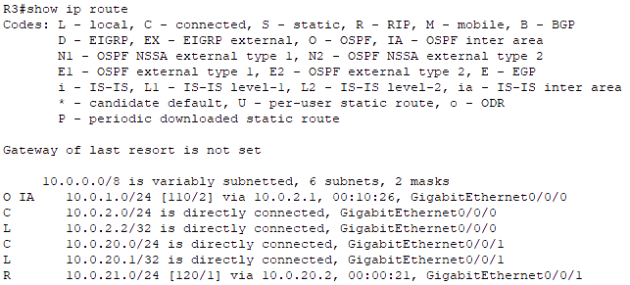
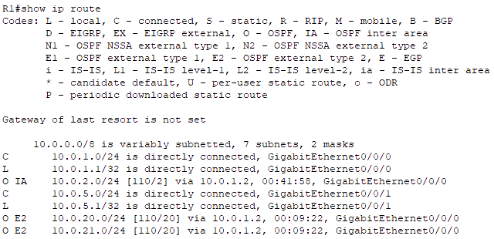
Area Types
The following commands on the ASBRs of OSPF standard area-
‘Router(config)# router ospf <process ID>’
‘Router(config-router)# network <network IP> <wildcard mask> area <non zero area ID>’
‘Router(config-router)# redistribute <external routing protocols> subnets’

Slide 11
Area Types
3.Stub Area: A stub area is a non-backbone area that only receives LSAs from the backbone area. Its is an optimization of standard area. Stub areas do not send LSAs to other areas and does not accept any external routes of non-OSPF network, if it wants to reach those external routes, only Need to send it through the default route. This area supports type 1, 2, and 3 LSAs. Stub area does not accept external routes(Type 5), it is replaced by default route.
Stub Area 2
Area 0
Standard Area 1
External Network RIP
External Network
G0/0/0
G0/0/1
G0/0/0
G0/0/0
G0/0/1
G0/0/0
G0/0/1
G0/0/0
R4
10.0.3.0/24
R1
10.0.1.0/24
R2
10.0.2.0/24
R3
10.0.20.0/24
Ex-RTR
ASBR
BR
BR
ASBR
G0/0/1
10.0.10.0/24
Type 1/2
ABR
Type 1/2
ABR
Type 1/2
10.0.21.0/24
10.0.11.0/24
Type 3
Type 3
Type 5
G0/0/0
Type 5
Default
Type 4
Ex-RTR

Slide 12


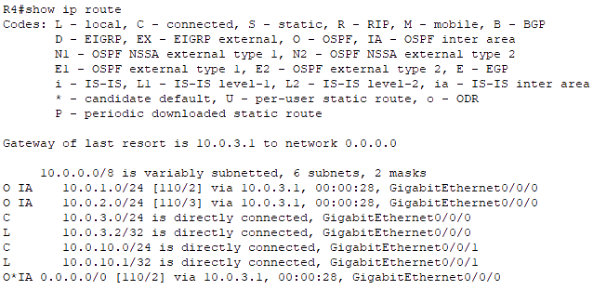
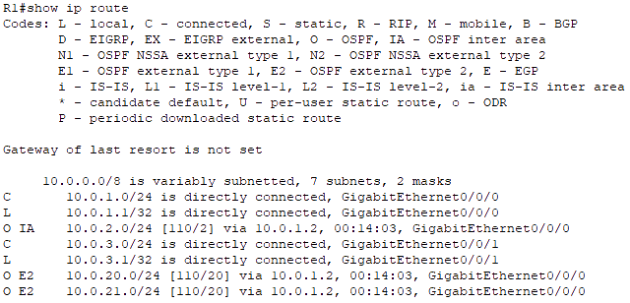
Area Types
The following commands on routers of OSPF stub area-
‘Router(config)# router ospf <process ID>’
‘Router(config-router)# network <network IP> <wildcard mask> area <non zero area ID>’
‘Router(config-router)# area <non zero area ID> stub’

Slide 13
Area Types
4.Totally Stubby Area: It is one step more strict Area than Stub Area. It means that the area does not accept external routes and does not accept the link information of other areas outside of their own area. This is a Cisco Proprietary OSPF Area. If it wants to reach the target network outside the area, it will send out the message through the default route just like the stub area. This area supports type 1, 2 and 3 LSAs with default routes.
Totally Stubby Area 3
Area 0
Standard Area 1
External Network RIP
External Network
G0/0/0
G0/0/1
G0/0/0
G0/0/0
G0/0/1
G0/0/0
G0/0/1
G0/0/0
R5
10.0.4.0/24
R1
10.0.1.0/24
R2
10.0.2.0/24
R3
10.0.20.0/24
Ex-RTR
ASBR
BR
BR
ASBR
G0/0/1
10.0.10.0/24
Type 1/2
ABR
Type 1/2
ABR
Type 1/2
10.0.21.0/24
10.0.11.0/24
Type 3
Type 5
G0/0/0
Type 5
Default
Type 4
Ex-RTR

Slide 14


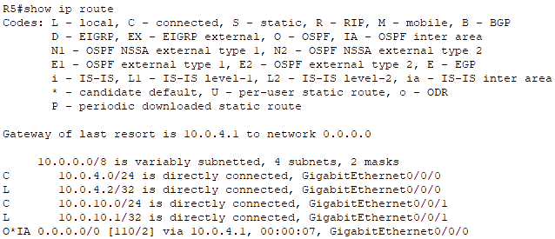
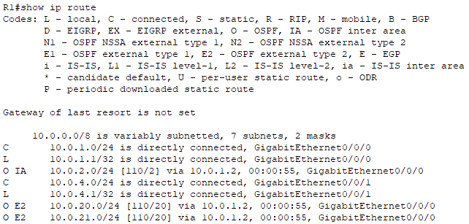
Area Types
The following commands on the ABR of OSPF totally stubby area-
‘Router(config)# router ospf <process ID>’
‘Router(config-router)# network <network IP> <wildcard mask> area <non zero area ID>’
‘Router(config-router)# area <area no> stub no-summary’
And on other routers-
‘Router(config-router)# area <area no> stub’

Slide 15
Area Types
5.Not So Stubby Area (NSSA): An NSSA is a non-backbone area that receives LSAs from the backbone area and from external networks. NSSAs do not send LSAs to other areas, but they can send LSAs to external networks. NSSAs are used when external routes need to be imported into OSPF while maintaining some area boundary restrictions. This area supports type 1, 2, 3, and 7 LSAs. Here type 7 LSAs are used which are similar to the type 5 LSA. Here the external links are advertised by the ASBR towards the ABR, which in turn will convert the LSA type 7 to LSA Type 5 and then flood it to the rest of OSPF network. Similar to other areas, type 1 and type 2 LSAs are used to build the topology tables. The type 3 LSAs are accepted by the NSSA thus can be used to reach other networks of other areas.
NSSA 3
Area 0
Standard Area 1
External Network RIP
External Network
G0/0/0
G0/0/1
G0/0/0
G0/0/0
G0/0/1
G0/0/0
G0/0/1
G0/0/0
R6
10.0.5.0/24
R1
10.0.1.0/24
R2
10.0.2.0/24
R3
10.0.20.0/24
Ex-RTR
ASBR
BR
BR
ASBR
G0/0/1
10.0.10.0/24
Type 1/2
ABR
Type 1/2
ABR
Type 1/2
10.0.21.0/24
10.0.11.0/24
Type 7
Type 5
Type 3
Type 5
G0/0/0
Type 4
Type 5
Default
Type 4
Ex-RTR

Slide 16


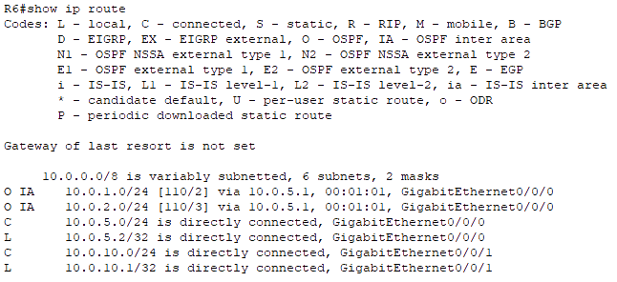
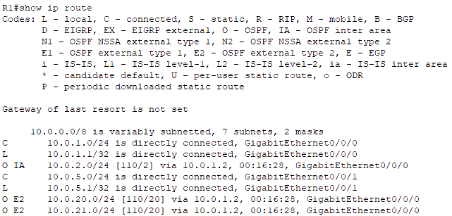
Area Types
The following commands on routers of OSPF stub area-
‘Router(config)# router ospf <process ID>’
‘Router(config-router)# network <network IP> <wildcard mask> area <non zero area ID>’
‘Router(config-router)# area <non zero area ID> nssa’

Slide 17
Virtual Link
Virtual links are used to connect a dis-contiguous area to area 0.
It is a logical connection built between routers.
To configure virtual link, firstly, identify the virtual area (standard area 1 in the following figure). Secondly, Identify the ABRs of virtual areas (R2 and R1 in the following figure). Thirdly, identify the router IDs of those ABRs. Stub or NSSA area doesn’t allow virtual link. Why?
R2-ID: 2.2.2.2
R3-ID: 3.3.3.3
Stub Area 2
Area 0
Standard Area 1
Standard Area 5
Standard Area 1
Standard Area 4
G0/0/0
G0/0/1
G0/0/0
G0/0/1
G0/0/0
G0/0/0
G0/0/1
G0/0/0
G0/0/1
G0/0/0
R9
10.0.6.0/24
R7
10.0.3.0/24
R1
10.0.1.0/24
R2
10.0.2.0/24
R3
10.0.5.0/24
R8
IR
ABR
BR
BR
ABR
IR
Type 1/2
Type 1/2
ABR
Type 1/2
ABR
Type 1/2
Type 1/2
Type 3
Type 3
Type 5
Default
Type 4

Slide 18
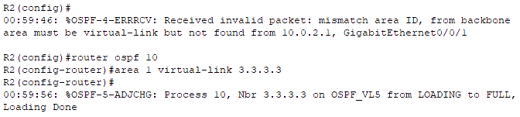

Virtual Link
Commands of virtual link on the ABRs- ‘Router(config)# router ospf <process ID>’
‘Router(config-router)# area <virtual area ID> virtual-link <ABR ID>’

Slide 19
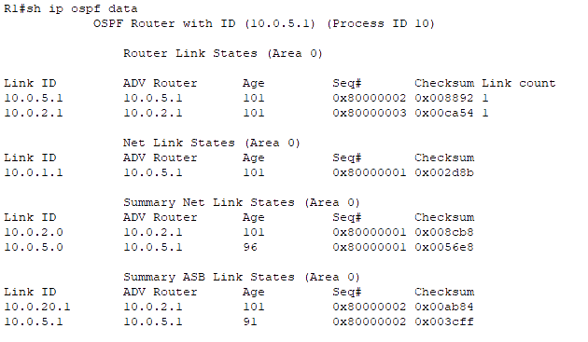
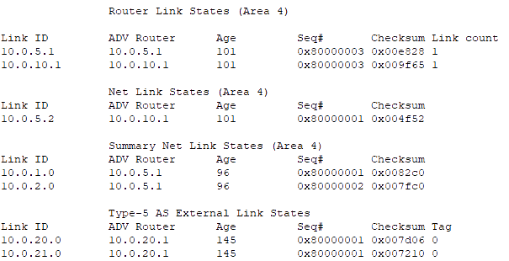

LSDB (Link State Database) Table

Slide 20
Network Types
There are two more types of OSPF network-
OSPF
4. P2MP (Point to Multipoint)
5. P2MP Non Broadcast
A point-to-multipoint (P2MP) OSPF network is a network where one router is connected to multiple other routers. This type of network is typically used for Frame Relay and ATM networks.
P2MP NBMA OSPF network type is used where OSPF routers are connected via NBMA networks, such as Frame Relay or X.25, and need to communicate with multiple neighbors over the same network segment.

Slide 21
Point-to-Multipoint Network
Spoke
P2MP networks are similar to P2P networks, but they support multiple remote routers connecting to a central router. The remote routers are not directly connected to each other.
Typically used in wireless or hub-and-spoke topologies.
The hub router maintains a separate OSPF adjacency with each of the remote routers.
Spoke routers establish OSPF adjacencies with the hub router but do not establish adjacencies with each other.
Adjacencies are established between all neighboring routers. There is no DR/BDR concept.
These type of network are not seen in LAN networks. They are commonly used in WAN scenarios such as: Remote site connectivity, branch office connectivity, wireless mesh networks and many more.
Hub
Spoke
WAN
Spoke
Full mesh WAN deployment are rare and generally not recommended.
Interfaces connecting Hub and Spoke will be in same subnet just like a OSPF broadcast network connected with a switch.

Slide 22
Network Type Differences
Network Type | P2P | Broadcast | NBMA | P2MP | P2MP NB
Max Routers per Link | 2 | ∞ | ∞ | ∞ | ∞
Full Mesh Connectivity Assumed | Yes | Yes | Yes | No | No
DR/BDR Election | No | Yes | Yes | No | No
Hello/Dead Timer (Cisco Default) | 10 / 40 | 10 / 40 | 30 / 120 | 30 / 120 | 30 / 120
Automatic Neighbor Discovery | Yes | Yes | No | Yes | No
Discovery & Periodic Hello sent to | 224.0.0.5 | 224.0.0.5 | Neighbor IP | 224.0.0.5 | Neighbor IP
Neighbor Communication sent to | 224.0.0.5 | Unicast | Unicast | Unicast | Unicast
LSA(s) sent to | 224.0.0.5 | Multicast DR/BDR | Unicast DR/BDR | Unicast | Unicast
Next-Hot IP | Peer | Originated Router | Originated Router | Hub | Hub

Slide 23
OSPFv2 Authentication
Authentication is used to prevent unauthorized or invalid routing updates in the network.
According to RFC 2328 (Arpril, 1998), there are three different types of authentication available for OSPF version 2: Type 0 - Null authentication: Null authentication means that there is no authentication, which is the default on Cisco routers. Type 1 - Clear text authentication: In this method of authentication, passwords are exchanged in clear text on the network Type 2 - Cryptographic authentication: The cryptographic method uses the open standard MD5 (Message Digest type 5) encryption.
The authentication type can be configured at the area level or at the interface level.
In either case, the password must still be configured at the interface level.
If both are configured, interface level configuration overrides area level configuration.
Clear Text (maximum 8 characters) Authentication is configured when devices within an area cannot support MD5 Authentication. It leaves the internetwork vulnerable to a "sniffer attack" — where packets are captured by a protocol analyzer and the passwords can be identified.
MD5 authentication provides higher security. This method uses the MD5 algorithm to compute a hash value from the contents of the OSPF packet and a password (or key). The hash value is transmitted in the packet, along with a key ID and a non-decreasing sequence number. The receiver, which knows the same password, calculates its own hash value. If nothing in the message changes, the hash value of the receiver should match the hash value of the sender which is transmitted with the message. The key ID allows the routers to reference multiple passwords. This makes password migration easier and more secure.

Slide 24
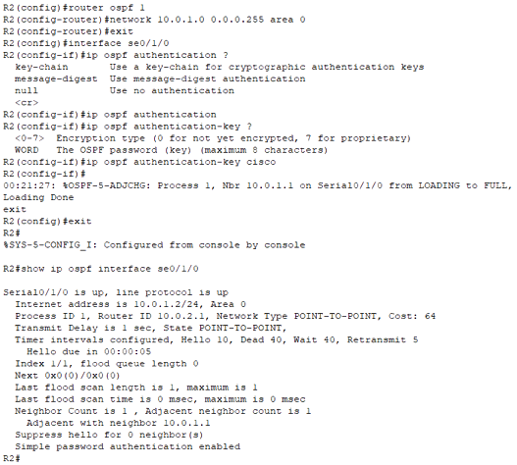
OSPFv2 Authentication Type 1 (Clear Text)
Area based clear text authentication commands- ‘Router(config)# interface <interface name>’ ‘Router(config-if)# ip ospf authentication-key <key value>’ ‘Router(config-if)# exit’ ‘Router(config)# router ospf <process ID>’ ‘Router(config-router)# area <area ID> authentication’ ‘Router(config-if)# exit’
Interface based clear text authentication commands- ‘Router(config)# interface <interface name>’ ‘Router(config-if)# ip ospf authentication’ ‘Router(config-if)# ip ospf authentication-key <key value>’ ‘Router(config-if)# exit’

Slide 25
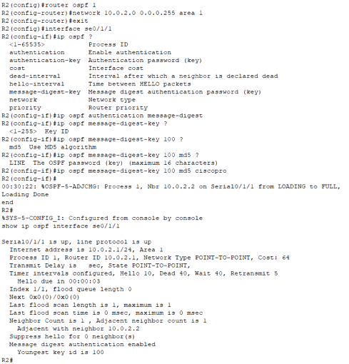
OSPFv2 Authentication Type 2 (Cryptographic – MD5)
Area based cryptographic MD5 authentication commands- ‘Router(config)# interface <interface name>’ ‘Router(config-if)# ip ospf message-digest-key <key num> md5 <key value>’ ‘Router(config-if)# exit’ ‘Router(config)# router ospf <process ID>’ ‘Router(config-router)# area <area ID> authentication message-digest’ ‘Router(config-if)# exit’
Interface based cryptographic MD5 authentication commands- ‘Router(config)# interface <interface name>’ ‘Router(config-if)# ip ospf authentication message-digest’ ‘Router(config-if)# ip ospf message-digest-key <key num> md5 <key value>’ ‘Router(config-if)# exit’

Slide 26
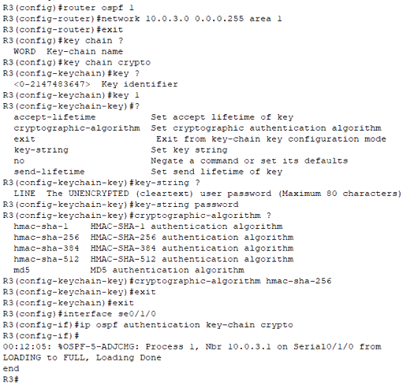
OSPFv2 Authentication Type 3 (Cryptographic – SHA)
After being compromised, RFC 5709 (October, 2009) allows OSPF to use HMAC-SHA algorithms for cryptographic authentication.
With the addition of SHA to type 2 authentication, it is now called cryptographic authentication for both MD5 and SHA.
It is similar to MD5 but more secure.
This is only available at the interface level & it uses key chains
Interface based cryptographic SHA authentication commands- ‘Router(config)# key chain <chain name>’ ‘Router(config-keychain)# key <key num>’ ‘Router(config-keychain-key)# key-string <string>’ ‘Router(config-keychain-key)# cryptographic-algorithm hmac-sha-256’ ‘Router(config-keychain-key)# exit’ ‘Router(config-keychain)# exit’ ‘Router(config)# interface <interface name>’ ‘Router(config-if)# ip ospf authentication key-chain <chain name>’ ‘Router(config-if)# exit’
Key identifier range will be <1-255>

Slide 27
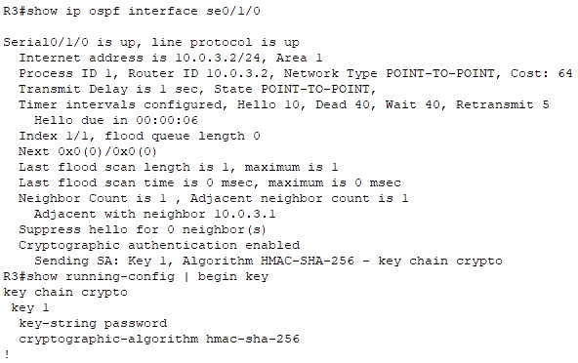
OSPFv2 Authentication Type 3 (Cryptographic – SHA)
The currently valid algorithms for OSFv2 Cryptographic Authentication include:
Keyed-MD5 (defined in RFC 2328)
HMAC-SHA-1 (defined in RFC 5709)
HMAC-SHA-256 (defined in RFC 5709)
HMAC-SHA-384 (defined in RFC 5709)
HMAC-SHA-512 (defined in RFC 5709)
HMAC stands for Hashed Message Authentication Code.
SHA stands for Secure Hash Algorithm.
Sending SA: Status of sending Security Association. Key, Cryptographic Algorithm and Key Chain used.

Slide 28
OSPFv3 Basic
OSPFv3 is based on OSPFv2 with enhancement.
It distributes IPv6 prefixes and runs directly over IPv6.
It adds IPv6 specific attributes like-
128 bit addresses.
Link-local address.
Multiple addresses and instances per interface.
Authentication (now uses IPsec).
OSPFv3 runs over a link, rather than a subnet.
IPv6 routing has to be enabled before using any routing process as by default IPV6 routing is disabled.
Router-ID in OSPFv3 must be in IPv4 format. If any loopback or physical interfaces in the router doesn’t have any IPv4 address, OSPFv3 cannot be configured without manually configuring its Router-ID manually in IPv4 format.
Commands for OSPFv3- ‘Router(config)# ipv6 unicast-routing’ ‘Router(config)# ipv6 router ospf <process ID>’ ‘Router(config-rtr)# router-id <router ID>’ ‘Router(config-rtr)# exit’ ‘Router(config)# interface <interface name>’ ‘Router(config-if)# ipv6 enable’ ‘Router(config-if)# ipv6 router <process ID> area <area ID>’ ‘Router(config-if)# end’ ‘Router# show ipv6 protocols’ ‘Router# show ipv6 ospf neighbor’

Slide 29
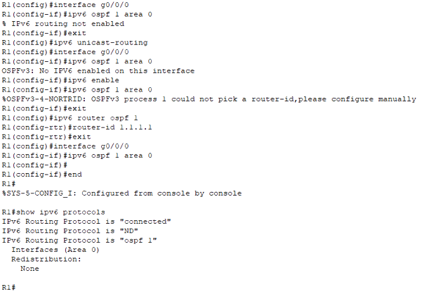
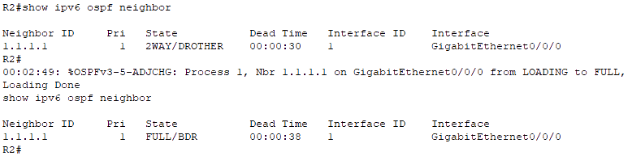
OSPFv3 Basic

Slide 30
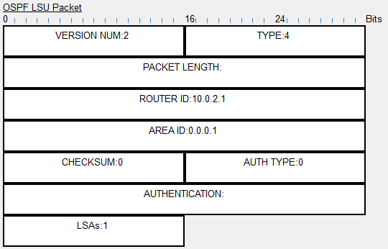
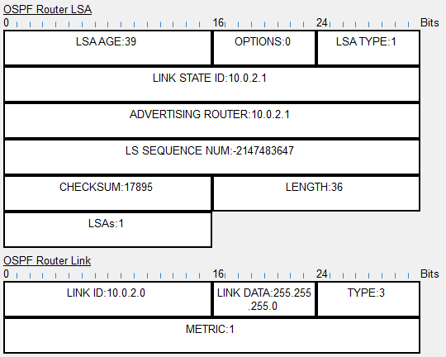
PDU – Router LSA

Slide 31
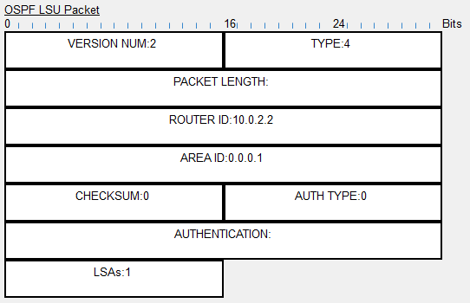
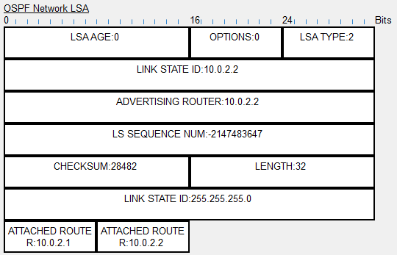
PDU – Network LSA

Slide 32



Thank You
Feel free to reach out to me for any suggestions or feedback via LinkedIn or Mail
www.github.com/smsufi
www.linkedin.com/in/smsufi
safwanm.cse@gmail.com

Slide 33
References
https://en.wikipedia.org/wiki/Open_Shortest_Path_First
https://www.youtube.com/@SIKANDARshaik/playlists
https://www.youtube.com/@kushalkabi/playlists
https://www.youtube.com/@Certbros/playlists
https://www.geeksforgeeks.org/open-shortest-path-first-ospf-protocol-states/
https://www.cisco.com/c/en/us/support/docs/ip/open-shortest-path-first-ospf/7039-1.html
https://www.javatpoint.com/ospf-protocol
https://www.n-study.com/en/ospf-detail/ospf-hello/
https://techhub.hpe.com/eginfolib/networking/docs/switches/5500hi/5998-5330_l3-ip-rtng_cg/content/351988006.htm#279688693
RFC 2328 - OSPF Version 2 (RFC2328) (faqs.org)
http://www.faqs.org/rfcs/rfc5709.html
https://support.huawei.com/enterprise/en/doc/EDOC1100278245/6cac587/understanding-ospfv3-authentication
https://www.arubanetworks.com/techdocs/AOS-CX/10.07/HTML/5200-7857/Content/Chp_OSPFv3/OSPFv3_cmds/ipv-osp-aut-ips-osp-10.htm
https://networklessons.com/ipv6/ospfv3-authentication-and-encryption

Slide 34
References
https://www.n-study.com/en/ospf-detail/ospf-lsa-type/
https://community.cisco.com/t5/switching/ospf-process-id/td-p/1405396
https://www.quora.com/What-is-the-purpose-of-OSPF-process-ID
https://www.youtube.com/@PracticalNetworking/playlists
https://www.router-switch.com/faq/five-ospf-area-types.html#:~:text=There%20are%20five%20types%20of,so%20stubby%20area%20(NSSA)
https://www.geeksforgeeks.org/ospf-area-types/
https://ipwithease.com/ospf-area-types/
https://ipcisco.com/lesson/ospf-area-types-ccnp/
https://www.youtube.com/@JeremysITLab/playlists
https://www.youtube.com/watch?v=m2M9akEsJao
https://community.cisco.com/t5/networking-knowledge-base/ospf-authentication/ta-p/3131640
https://info.pivitglobal.com/resources/configuring-ospf-authentication
https://www.cisco.com/c/en/us/td/docs/ios-xml/ios/iproute_ospf/configuration/xe-3s/iro-xe-3s-book/iro-ospfv2-crypto-authen-xe.html

